Slide 1
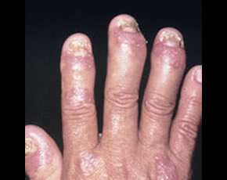
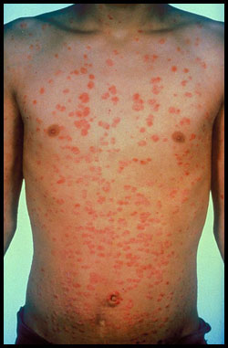
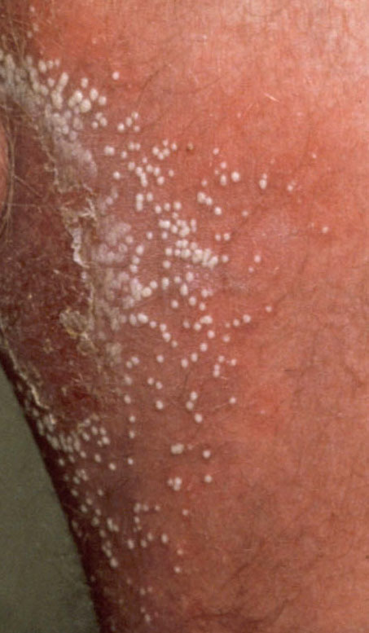
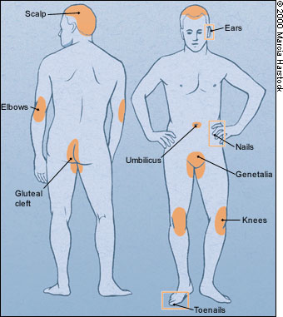
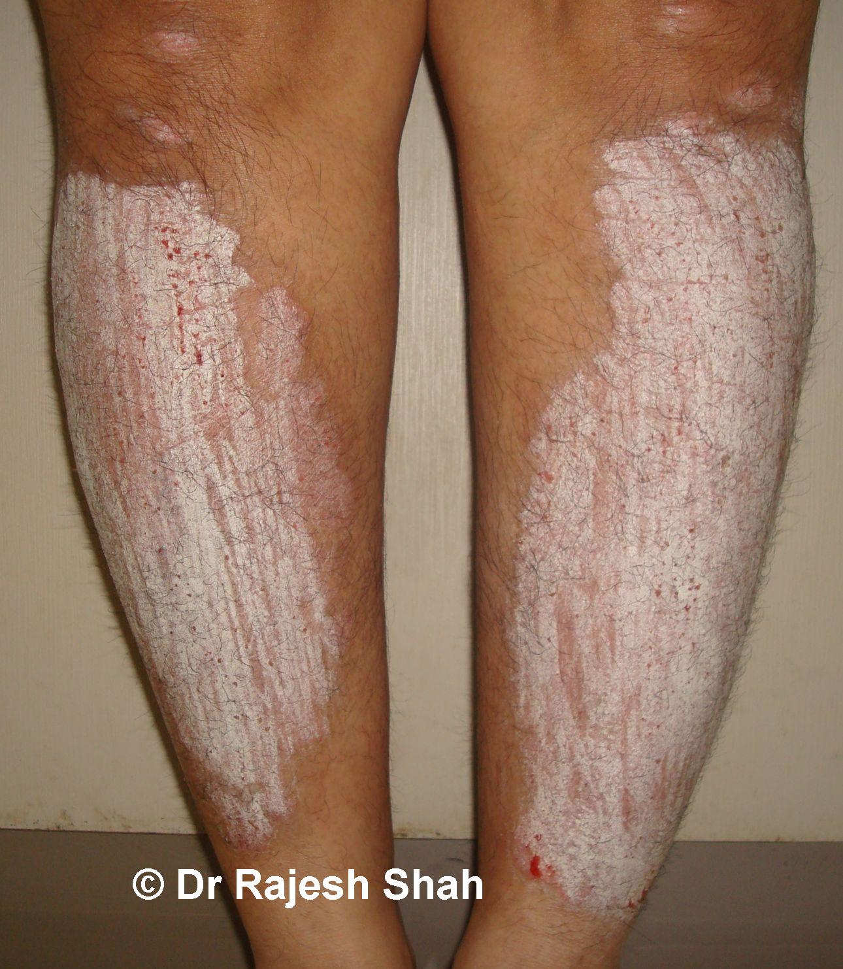
Variants of Psoriasis
Psoriatic arthritis
&
Psoriasis of the Nail
Rapid Growth
Plaque psoriasis
Guttate psoriasis
Pustular psoriasis

Slide 2
Psoriasis:
Psoriasis is a common skin condition that causes skin redness and irritation. Most people with psoriasis have thick, red skin with flaky, silver-white patches called scales.
Immune:
Epidermal growth factor appear on skin
Cytokines such as interleukins and interferons are over expressed
TNF alpha is over expressed
Skin
Keratinocytes located in in the basal layer of the skin
matures within 1-4 days (normal is 1 month) which results in epidermal plaque
Causes | Examples
Drugs | Beta blockers Chloroquine (malaria) ACE-I Progesterone Lithium
Weather | Dry and Cold Light

Slide 3
Treatment (No Cure)
Topical (most common)
Systemic Treatment + Phototherapy (PUVA)
Biologicals

Slide 4
Topical Treatment: Corticosteroids
DOC because:
Reduce inflammation
Inhibit cell proliferation
Anti-pruritic
Limit to 3 week of continuous use
Corticosteroids | Generic | Brand
Low Potency (face) | Fluocinolone Hydrocortisone | Synalar Synacort, Penecort, Hytone
Medium Low Potency | Hydrocortisone Hydrocortisone Valerate | Locoid Westcort
Medium High Potency | Fluticasone Propionate Clocortolone Pivalate | Cultivate Cloderm
High Potency (elbow and knees) | Betamethasone Mometasone Furoate Halobetasol propionate Diflorasone Diacetate Clobetasol | Diprolene Elocon Ultravate Maxiflor, Florone, Psorcon Temovate

Slide 5
Topical | MOA | Notes
Emollients | Hydrate stratum corneum Enhance desquamation
Salicylic Acid | Removes Scales | Keratolytic
Coal Tar | Inhibits enzyme that contribute to cell proliferation
Anthralin (Drithocreme) | Inhibits DNA synthesis and cell proliferation | Coal tar like product Used in Chronic psoriasis Use overnight
Calcipotriene (Dovonex) Calcitriol (Vectical) | Regulates cell proliferation and suppresses lymphocytic activity | $$$ Vit D3 analog
Tazarotene | Topical Retinoid (Vitamin A derivative) | Tx: mild to moderate psoriasis Improve within 1 week Pregnancy X
Tacrolimus (Protopic) & Pimecrolimus (Elidel) | Calcineurin Inhibitors | Use for eczema (not as efficacious) Good for facial lesions Good for axillary psoriasis Not 1st line b/c may cause skin cancer

Slide 6
Systemic Treatment + Phototherapy
Methotrexate (Rheumatrex)
MOA | Anti-folic acid analog: blocks purine synthesis
Max Dose | 25 mg PO Weekly
Effect | Improvement within 4 weeks
Toxicity | Hepatotoxicity is a cumulative effect
Monitor | Liver AST/ALT every 1-3 months. If elevated AST/ALT over 12 months, then do liver biopsy
D-D | Affecting Renal: NSAIDS Salicylates Protein binding: Salicylate Phenytoin warfarin retinoids

Slide 7
Methotrexate
Monitoring for Hepatoxicity
AST/ALT every 1-3 mos
NO risk factors
WITH risk factors
- AST normal
- Cum. dose: 3.5 – 4 g
- 5 of 9 AST ↑ over 12 mos
- Albumin ↓
- AST normal
- Cum. dose: 1 – 1.5 g
Liver Biopsy
Notes:
Not important for exam

Slide 8
Acitretin (Soriatane)
Use | For more resistant psoriasis
MOA | regulates cell reproduction Metabolite of etretinate
Toxicity | Category X for both Males and Females Hyper-Vitaminosis A Syndrome Soft nails Skin thinning Hair loss
D-D | Do not take with alcohol b/c drug convert back to etretinate and will stay in body for years

Slide 9
Biologicals
Biologicals | Dosing
Alefacept (Amevive) | 7.5 mg IV once week or 15 mg IM once weekly
Etanercept (Enbrel) | 25 mg SC twice weekly
Efalizumab (Raptiva) (removed from market) | Removed from market b/c Progressive multifocal Leukoencephalopathy
Ustekinumab (Stelara)
MOA | Target interleukins 12 and 23 → slows hyperkeratinization of cells
If pt < 100 kg | 45 mg SQ Repeat in 1 month then Repeat every 3 months
If pt > 100 kg | 90 mg SQ Repeat in 1 month then Repeat every 3 months

Slide 10
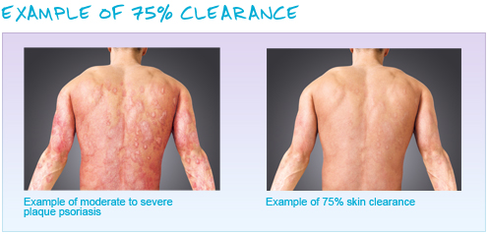
Ustekinumab Effectiveness
AWP for ustekinumab 45 mg vial: $5,595.60
Notes:
hUman

